Slide 1

Supported by - TANISHKA CMRC
PREMANKUR
- SAMAJIK SANSTHA -
Stree Style

Slide 2
Who are we?

Slide 3
PREMANKUR (PSS) SKILL TRAINING CENTRE works towards empowering women by forming local Self Help Groups.
PSS initiated an activity called Stree Style in 2018.

Slide 4
PSS coverage IN DHARAVI …
Sr. No. | Indicators | Coverage
1 | No. of SHG within PSS | 196
2 | Geographical Coverage | 5 TO 8 K.M radius
3 | Average Member Size in SHGs | 12
4 | Total Member | 2240
 | BPL | 33
 | PRA BPL | 2134
 | APL | 73

Slide 5
Where do we work?

Slide 6
Dharavi
Dharavi, one of the world’s largest slum, has an active informal economy in which numerous household enterprises employ many of the slum residents leather, textiles and pottery products are among the goods made inside Dharavi.

Slide 7
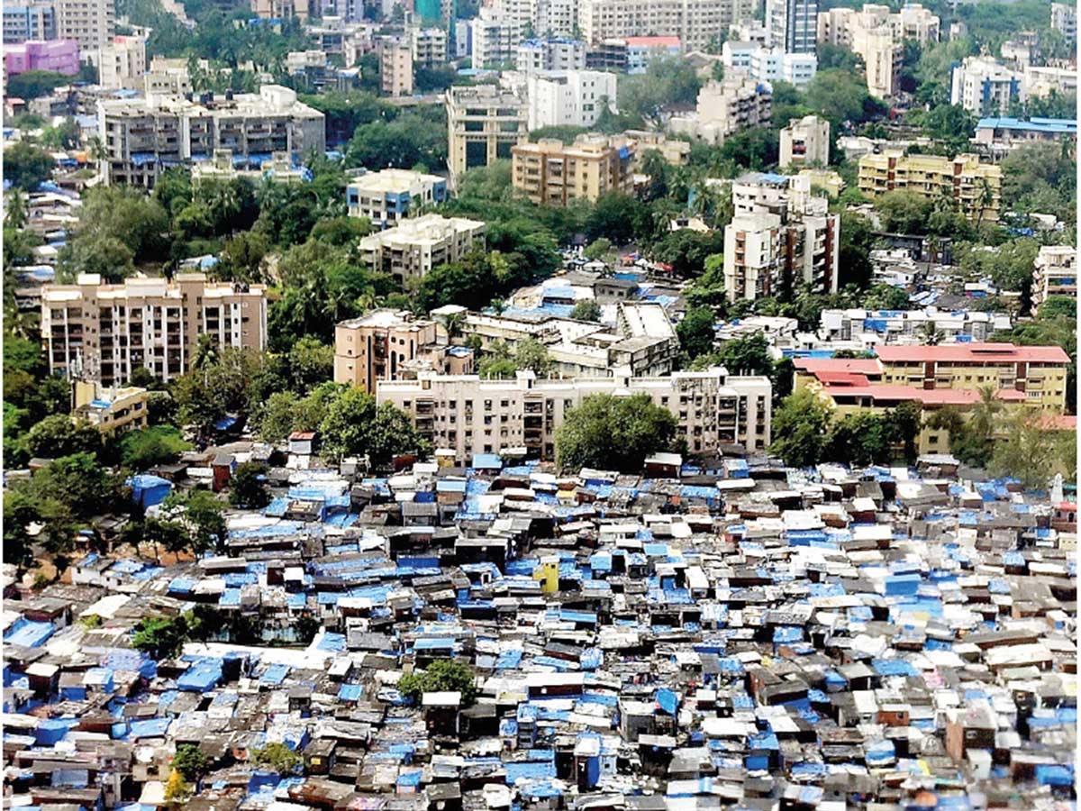

Slide 8
Did you know?

Slide 9
By 2030,
The total amount of fashion waste is expected to be 148 million tonnes which is equivalent to 17.5kg per person across the planet

Slide 10
Sixth Economic Census
Women constitute only 13.76% of the total entrepreneurs which is 8.05 million out of the 58.5 million entrepreneurs!

Slide 11
What do we do?

Slide 12
Collect pre-production waste from
manufacturers, designers, tailors et al.

Slide 13
Train women of our Self Help Groups (SHG)
8 women were trained in to make 12 products

Slide 14
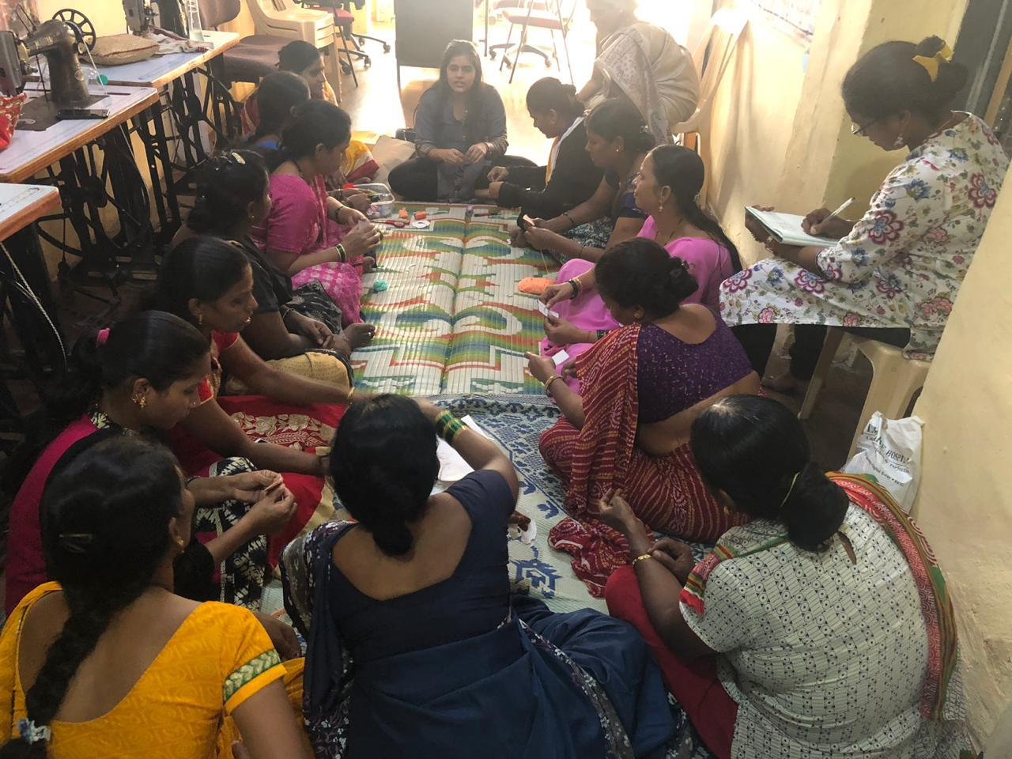

Slide 15
Provide Forward Market Linkage
through effective marketplace, branding, promotion & marketing.

Slide 16
How are we different?

Slide 17
Each Stree has a significant influence at each stage in the product life cycle
Each ‘Stree’ actively participates in the product design process
Each product is unique and is tagged to the ‘Stree’ who has produced it
Each of product is a unique handicraft with its distinct style and design based on the material that is up cycled

Slide 18
Tanishka has been working to break the stereotype that good quality products can only be produced in big factories of branded companies. In our initiatives, housewives from streets of Mumbai came together to make high quality and innovative products loved by all
Empowering women and help them build confidence is a key component of all our initiatives

Slide 19
What are our products?

Slide 20
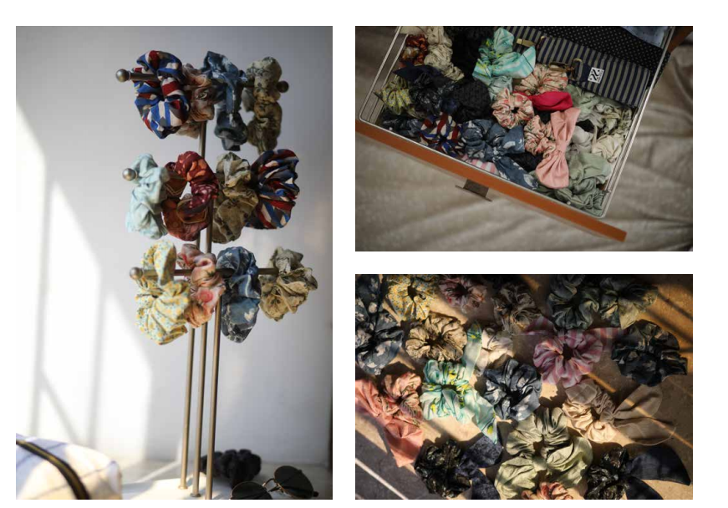
SRUNCHIES

Slide 21
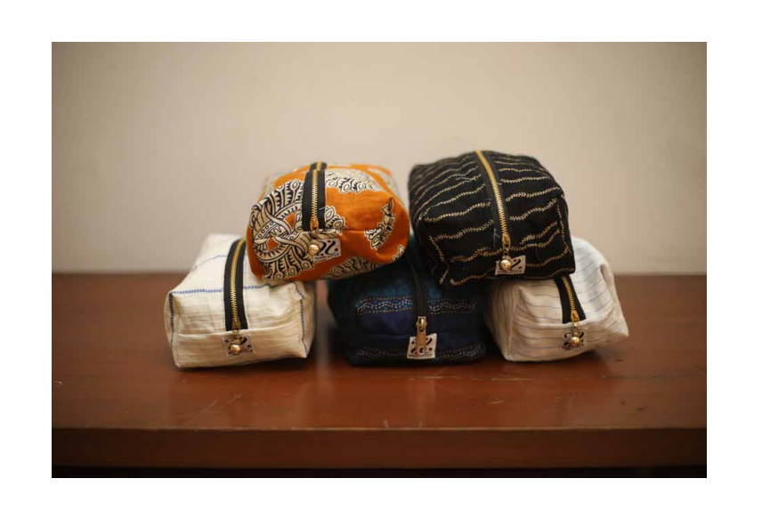
POUCH

Slide 22
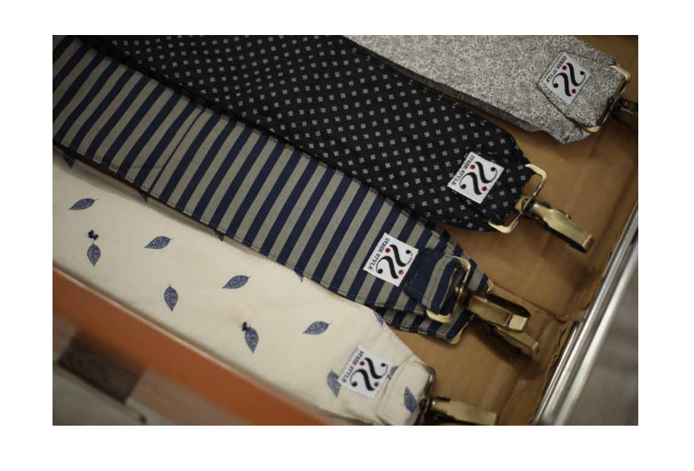
BAG STRAPS

Slide 23
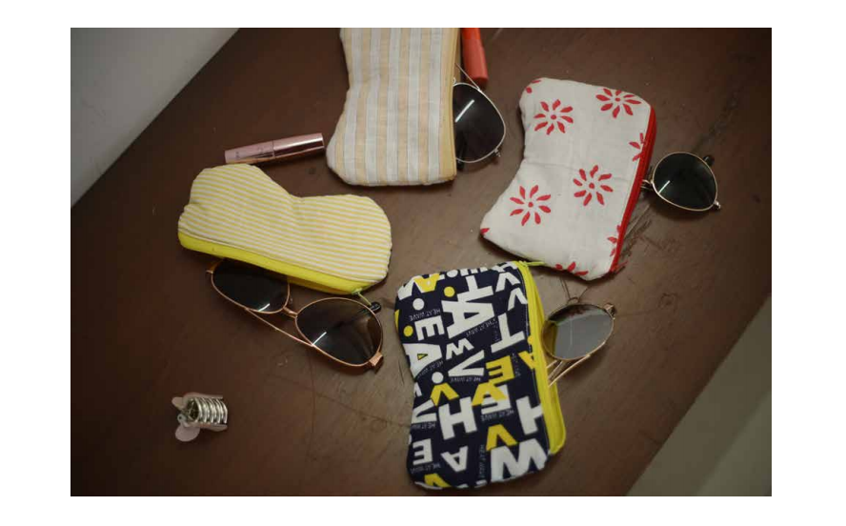
SUN GLASSES POUCH

Slide 24
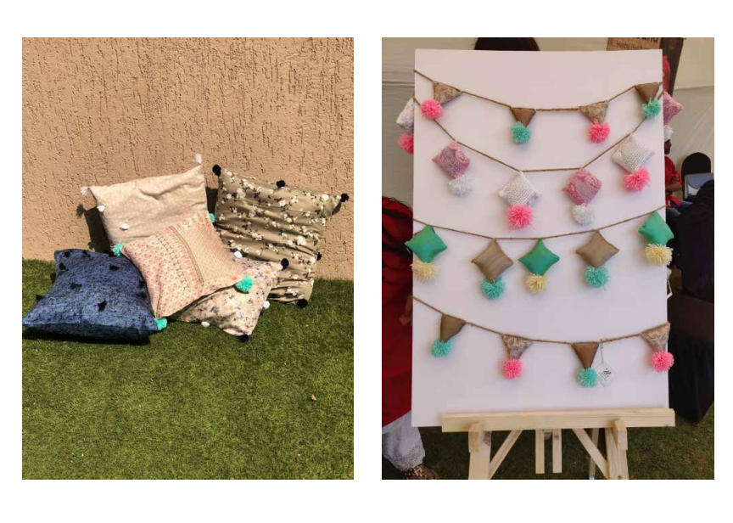
PILLOW COVER & WALL HANGING

Slide 25
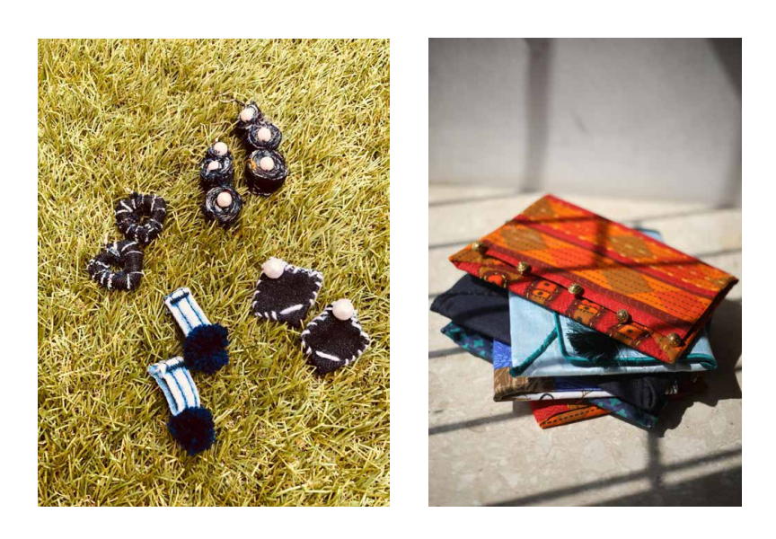
EARRINGS & CLUTCH

Slide 26
Where have we been?

Slide 27
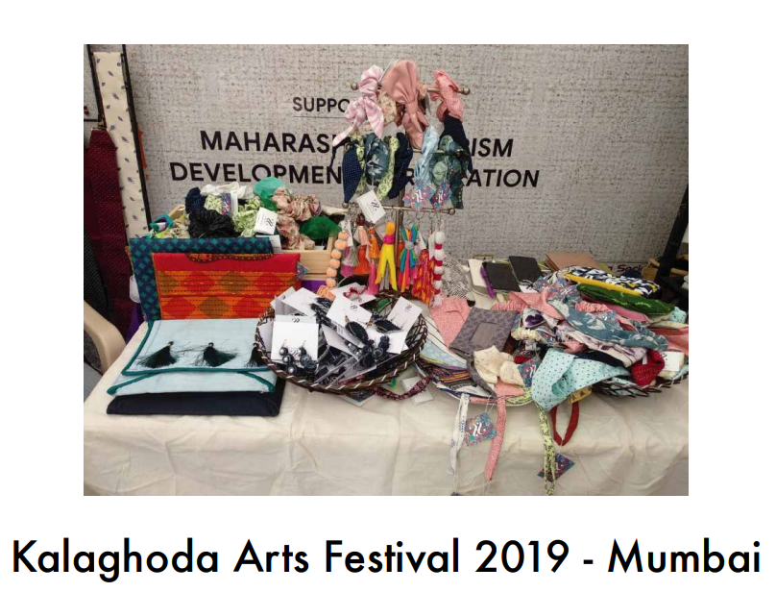

Slide 28
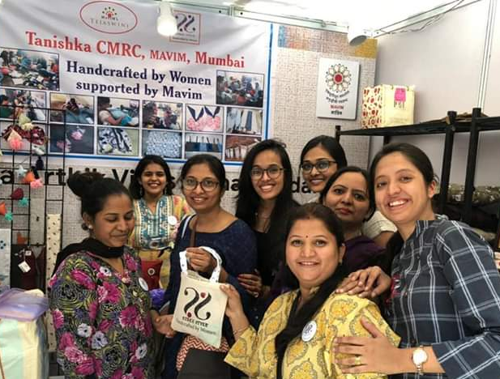
The stall was set up on 2nd February 2019
A total sale of INR 1.5 Lakhs was made at the Kalaghoda Exhibition

Slide 29
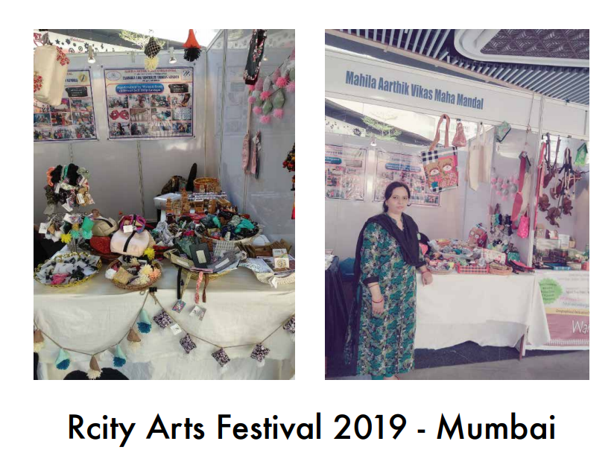

Slide 30
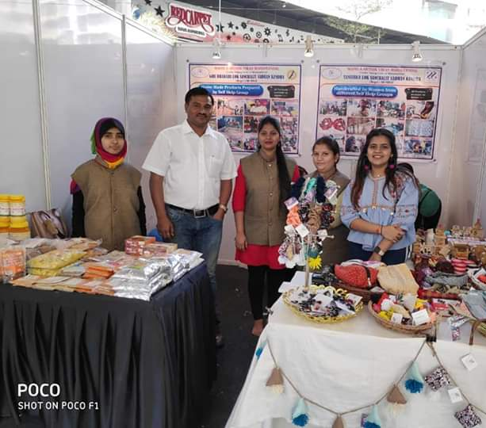
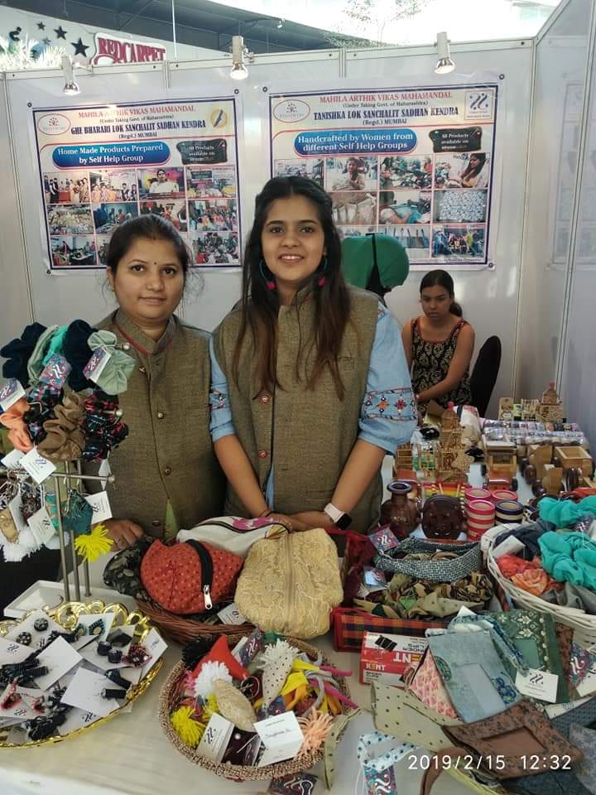
The stall was set up on 14th March 2019
A total sale of INR 15,000 was made at the RCity Mall Exhibition

Slide 31
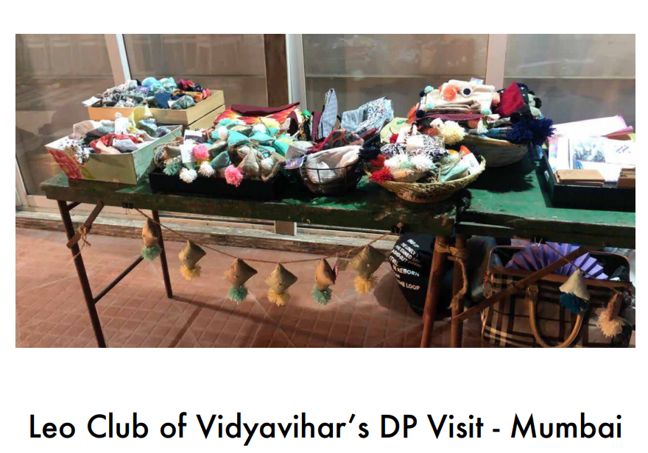
A total sale of INR 8,000 was made at the Leo Club Exhibition

Slide 32
Challenges

Slide 33
How to make local women make designer products with proper finishing
Finding market for the product – forward backward linkage
Finding a permanent place to sell the product
Exhibition charges are high if we want to sell at big places however we there is no certainty about sale

Slide 34
Solution

Slide 35
We trained our women for 3 months on how make high quality products with proper designing and finishing
Several efforts were made to keep the women motivated. We made them understand that they are in the process of building a brand at Kalagodha
We also recognized which women were good at what and then accordingly distributed the work

Slide 36
Future Plans

Slide 37
Expand our customer base and sell our products at Exhibits/Stalls/Malls round the year. We are planning to sell the products on Amazon Program
Provide our women an opportunity to become social entrepreneurs
Develop a brand named which makes high quality innovative products from waste
Add more variety to our current range of products and train women on how to make the same
Collaborating with brands such Johnsons to train our women and purchase our product as part of their CSR

Slide 38
Meet Our Team

Slide 39
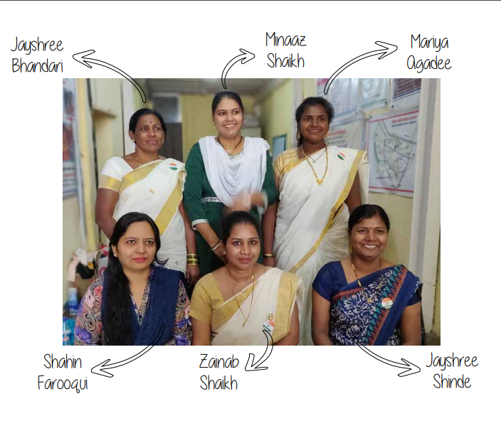

Slide 40
Thank You!

